Slide 1
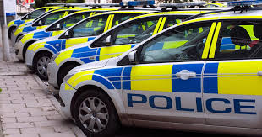
Hate Crime Risk Assessment
Improving police service to hate crime victims, safeguarding and reducing risk of repeat victimisation

Slide 2
Hate crime risk assessment relevance
Involved in co-production of two hate crime risk assessment models for police
Nottinghamshire Hate Crime Risk assessment 2016 (and subsequent amendments)
Dyfed and Powys Risk Assessment 2021

Slide 3
RELEVANT ARTICLES
Trickett, L. and Bryan, T., 2025. Aligning police practice with hate crime theory: The case for using risk assessments to improve police response to victims of hate. International Review of Victimology, 31(1), pp.22-38.
Bryan, T. and Trickett, L., 2021. “It’s not Really Hate Crime”–Reframing Hate Crime as not Police Business”–Police Narratives of Resistance and Denial. Journal of Hate Studies, 17(1), pp.74-84.

Slide 4
Hate CRIMES
The law recognises five types of hate crime: Race, Religion, Disability, Sexual Orientation,Transgender Identity. These crimes are covered by legislation (Crime and Disorder Act 1998 and section 66 of the Sentencing Act 2020) which allows prosecutors to apply for an uplift in sentence for those convicted of a hate crime.
The police and the CPS have agreed the following definition for identifying and flagging hate crimes: "Any criminal offence which is perceived by the victim or any other person, to be motivated by hostility or prejudice, based on a person's disability or perceived disability; race or perceived race; or religion or perceived religion; or sexual orientation or perceived sexual orientation or transgender identity or perceived transgender identity."

Slide 5
Persistent issues
Under-reporting, secondary victimisation, dissatisfaction and distrust in policing.
Victims of hate crime are less likely to be satisfied with the response they receive from criminal justice agencies compared to victims of other crimes, according to the Crime Survey for England and Wales (CSEW). They are more likely to be very dissatisfied with the police handling of the matter and less likely to feel the police treated them fairly or with respect.

Slide 6
College of Policing Guidance 2020 – updated 26th January 2022
The College of Policing (CoP) published updated guidance on how the police should respond to hate crime in October 2020. The Authorised Professional Practice guidance on hate crime
Hate crimes should be treated as priority incidents and consideration given to the most effective response that balances the needs of the incident, police resources available and the nature of any risk. Those responding to a hate crime should:
undertake an effective investigation to identify and bring offenders to justice
signpost victims, and where appropriate communities to appropriate support
reduce repeat victimisation

Slide 7
Risk Assessment
Risk assessment
At all stages of an investigation, police officers and staff must be aware of potential risks to the safety, vulnerability and wellbeing of victims. An important risk is the potential for further victimisation. Victims may be targeted either because they are perceived to be less likely to have the confidence to defend themselves physically or because they lack the confidence or ability to stand up to the offender. Risk factors may include: the victim’s isolation, for example, they have limited support or live alone, they have particular personal characteristics which may increase their vulnerability that there are particular issues that leave them susceptible to intimidation
A risk assessment should identify and enable the management of risks through appropriate actions. Victims’ assessment of their own safety should be considered as this is often a good indication of likely risk. Where a victim has communication difficulties or is particularly vulnerable, they should be supported to be able to explain the harm that has been caused and the risks they face.
Risk assessment and management is a dynamic process subject to constant change. The level of risk should be reviewed regularly, along with any interventions put in place, to ensure that they remain appropriate to the situation, provide reassurance and reduce the likelihood of further victimisation.
To ensure openness and accountability, a record of this risk assessment should be kept and regularly reviewed for quality assurance purposes and identifying trends.

Slide 8
Hate crime risk assessment
Direct victim - Context of victimisation, impact, history, personal issues
Local, national, international events
Potential for escalation and accumulation

Slide 9

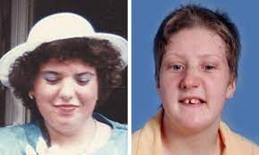
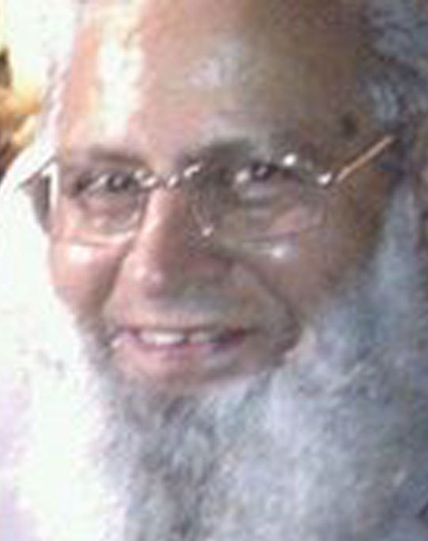

Case studies

Slide 10
Benefits
One of the most important lessons from the Stephen Lawrence case is the importance to recognize hate crime when it happens.
Police officers often fail to grasp the underlying philosophy and seriousness around hate crime, meaning that an enhanced service is not provided in practice.
We suggest that risk assessments, tools which are designed to assess a victim’s risk of potential future victimization, not only help the police to implement safeguarding, but can also provide a fuller understanding of the impact and harms of hate crime, so that responding police officers have more holistic perspective.
Globally, the development of risk assessment for hate crime victims is still in its infancy.

Slide 11
HMICFRS 2018 Nottinghamshire Police Hate Crime RA
In 2018 the HMICFRS Inspection Report highly commended the Nottinghamshire Police hate crime risk assessment implemented in 2016 as a comprehensive example of secondary risk assessment,
The Nottinghamshire hate crime risk assessment asked 27 questions of victims divided into four sections which are based on: information about the incident reported; information about the perpetrator; questions about previous victimisation and information about impact. At the end of the RA the completing staff member answered four diagnostic questions about current harm, risk of harm through repeat victimisation, community cohesion (designed to tap into local, national or international aggravating factors) and confidence in Nottinghamshire Police. Once the officer had completed the compulsory questions on the risk assessment with the victim, the officer then used their professional judgment to provide an overall level of risk of standard, medium or high.
The risk assessment was subsequently reviewed by a supervisor and a final assessment of overall risk was endorsed; this rating defined further levels of safeguarding activity in the case beyond investigation – providing a clear of example of how risk assessment must be matched by risk management working with partner agencies.
This risk assessment informed the development of an RA with Dyfed and Powys Police and an evaluation using a survey and focus groups with officers in the following roles: The policing respondents were involved in a variety of different roles

Slide 12
Survey benefits
It can focus minds and the ensure the correct level of response, if they follow the risk assessment.
Provides evidence on the crime as to the grading of the HC
Useful to have a scoring system as a benchmark indicator of the level of risk.
Gives a better breakdown of risks for the supervisor to review. Prevent further victims, reduce risk,

Slide 13
SURVEY: Additional support
A more sympathetic supportive touch towards the victim “
Additional support in terms of signposting and an understanding from staff of how these types of crime have an impact on victims
The victim may feel particularly vulnerable as a result so may require extra support. The person may also be a repeat victim therefore needing further support and preventative measures to be put in place

Slide 14
SURVEY: Victim satisfaction
Needs a more sensitive approach to gain customer satisfaction. Cannot send a bull into a china shop
I feel it is important to provide an extra layer of support to the victim, so they know the police take hate crime seriously

Slide 15
Focus groups – wider impact
Officers felt that there were numerous things that could go wrong both for the individual victim and the wider community which the Risk Assessment was designed to prevent:
…usually with something like homophobic or disability it is usually quite personal to one person or a couple whereas particularly with the racial element there is always the risk it is going to turn into something wider than one person or family. If you have hate against a person – that can lead to a group or a community being targeted, so from a racial perspective it is always a risk that it will be a wider issue outside of a person or couple

Slide 16
BENEFITS OF INFORMAL APPROACHES
We would have to engage with our neighbourhood teams, the hate crime support officers support the victims. So maybe talking with the suspect. Where it’s not going to court, if no further action. Just having a chat with them about what we can do to stop it happening
My most recent one was a term used by brother and sister towards the victim. It was racist but they didn’t know that the person had that ancestry. The victim just wanted the people spoken to. If it is going to court, a person might not speak to police, as there is a solicitor there. But as it was not going to court, I was able to better explain it to the suspects. So, to leave a thought in their minds that if they continued with that, I would be straight back arresting them for a racially motivated offence. Explaining how that term could be perceived, leaving a threat in the mind they will be arrested.

Slide 17
Who benefits from ra?
The Police, in terms of us, it shows the rationale for how we do things
Police are less likely to miss something significant, alerts you to vulnerability of victim and helps look at wider issues
For police, most of the questions, you ask normally in the conversation, it formalises it. It’s fairly simple to use I think and stops you forgetting anything
Victims and the police, able to identify the vulnerable, who is isolated in community and find out if it is a one-off incident or repeat
Risk assessment is needed as it will safeguard victims, it is focused on them and how they feel

Slide 18
Increased satisfaction
The last one I dealt with I think the victim benefitted greatly because the call wasn’t just a simple HC support officer saying - Do you need some support from me? I think for the individual, she was a partial amputee, it gave her the opportunity to almost have a little chat and get it off her chest a bit…from the victim side she felt a lot more support to vent how she was feeling. She felt we were listening a bit more. Before the victim support bit was, I think, more clinical - If you need victim support, we can give you extra things. What do you need? Whereas the questions on this risk assessment gave her more opportunity to really discuss the issues and how she was actually feeling
The officer goes on here to suggest that this was a turning point in the force’s previous dealings with the victim: She’s not got the best relationship with police to be honest over the years – causing us issues. Which is why I came away from that call thinking ‘Well that was quite good’ - because she’s not hugely pro policing in the past. But to get that conversation going with someone and I think that is purely from how that form is designed, the questions, it gave her that opportunity to know that we were listening, not like past experiences where we simply offered support

Slide 19
FINAL THOUGHTS
Officers were largely supportive of having hate crime risk assessments considering them to be of benefit to both victims and police because they helped to provide depth, clarify the type of support that victims might need., and provide a consistent response:
…. I do find the risk assessments are good because you can look through them, rather than police just putting the basics on there (crime record). The risk activity of doing the risk assessment, causes officers to go into more depth, and ask the questions which need to be asked, you have a clearer picture then, from reading the risk assessment, of the person who needs support
… yes, we have been able to make sure everybody safe… we can look at them, so if your risk is high, it will come to Neighbourhood Policing Team, whereas it might have got missed before. So that's a positive. And then in turn it benefits the person being affected because we know we're doing everything we possibly can for them …there’s definitely risks to hate crime, they [the risk assessment] help to avoid the worst-case scenario where somebody could end up harming themselves or another person
… they [the victims] are happy that we have taken it [hate crime] seriously and we are offering them the support, and everything we can do to try and help them. I think they're just glad to know that Dyfed and Powys do take it seriously, as a force

